Slide 1

DATA IN ACTION
Facilitated by:
Department of Research & Evaluation
Laura Davidson
Kyle Kemp
JT Stark
August 1, 2025
Notes:
Laura. Welcome & Intros

Slide 2

Data in Action: Today’s Learning Intentions
I understand the purpose of the data scope and sequence and can identify the most relevant data to review each month.
I am starting to uncover potential root causes in attendance and assessment data to guide further investigation and develop targeted Tier 1-3 strategies.
I can engage staff in making meaning of data by connecting patterns found in analysis to observations and practice.
Notes:
1 minute

Slide 3
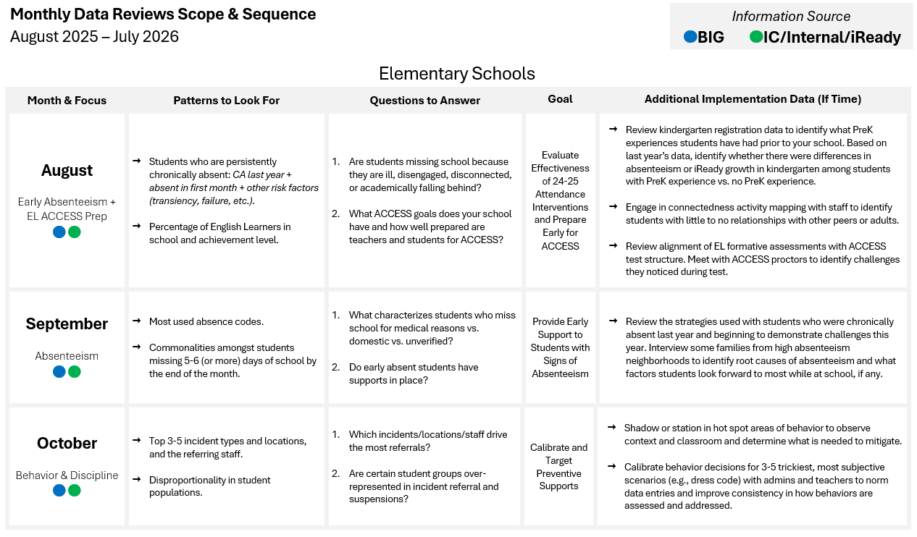
New This Year: Data Scope & Sequence
Separate Scope & Sequence for ES, MS, and HS to ensure relevance and alignment at each school level.
Monthly focus on targeted quantitative analysis, immediately followed by implementation strategy design and progress monitoring.
Shared district-wide topics each month to encourage collaboration and idea-sharing among school leaders.
District leaders and central office teams are ready to support schools with data interpretation, strategy development, and implementation follow-through.
Notes:
1-2 minutes

Slide 4
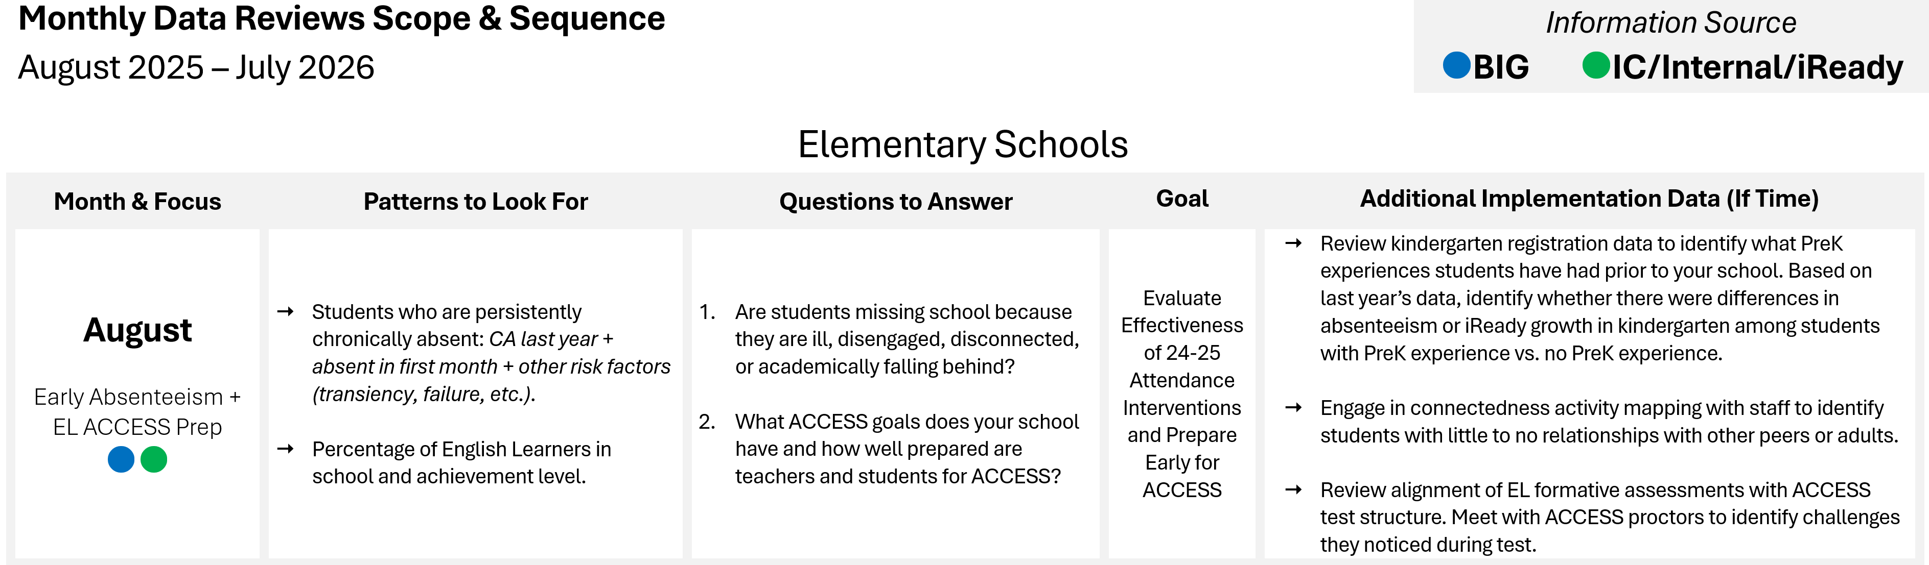
New This Year: Data Scope & Sequence
Notes:
1-2 minutes

Slide 5
New This Year: Data Scope & Sequence
August & September Data Scope & Sequence Focus
Absenteeism
Notes:
Pass to JT.

Slide 6

Chronic Absenteeism Calculation Insight
Awesome Antonio starts with us on the first day of school!
Enrolled Days
Absent Days
%
10
1
10%
Chronically Absent
25
3
12%
Chronically Absent
35
5
14%
Chronically Absent
65
10
15%
Chronically Absent
Chronically Locked
100
18
18%
Chronically Absent
180
18
10%
Chronically Absent
Notes:
1 minute

Slide 7
What happens when a lot of students
lock early?
Weekly monitoring becomes frustrating because the percentage always appears in the same range.
Highlights importance of early action.
Aug
Sep
Oct
Nov
Dec
Jan
Feb
Mar
Apr
May
Jun
Jul
Notes:
2 minutes

Slide 8
What happens when a lot of students
lock early?
Shift progress monitoring to stunt the sheer number of days absent.
What data can help inform chronic absenteeism all year long?
Aug
Sep
Oct
Nov
Dec
Jan
Feb
Mar
Apr
May
Jun
Jul
Notes:
1 minute

Slide 9
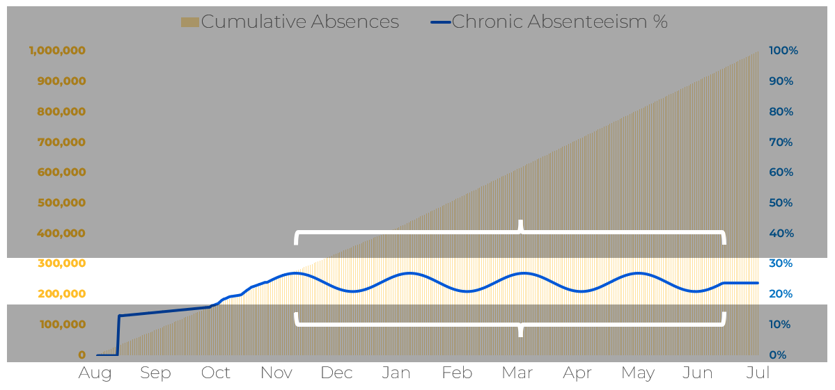
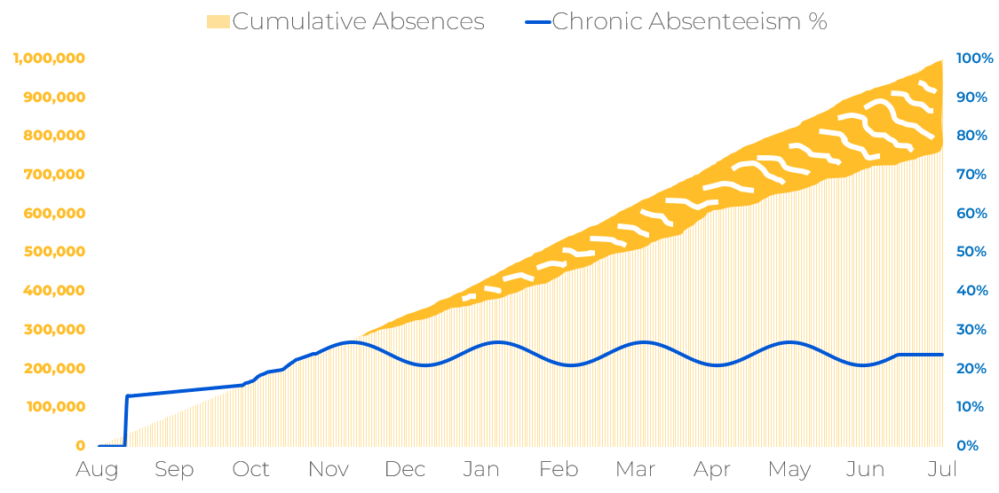
Have you recognized this at your school?
What additional data should we consider when schools are showing high rates of CA mid-year, and have a high percentage of students who locked mathematically?
How do we decide which students are most at-risk to intervene with when resources are limited?
How do we know if our interventions and attendance campaigns are working?
Notes:
5-7 minutes
5 minute table discussions; 2 minute whole group share out.

Slide 10
Have you recognized this at your school?
BIG’s Absenteeism Dashboard Usage
2024-2025
2023-2024
You know the data.
Let’s talk progress monitoring…
Notes:
5-7 minutes
5 minute table discussions; 2 minute whole group share out.

Slide 11
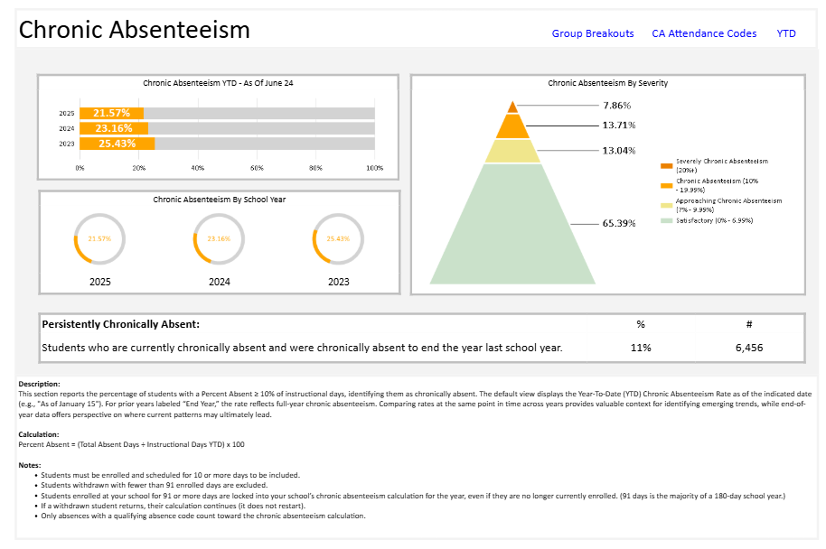
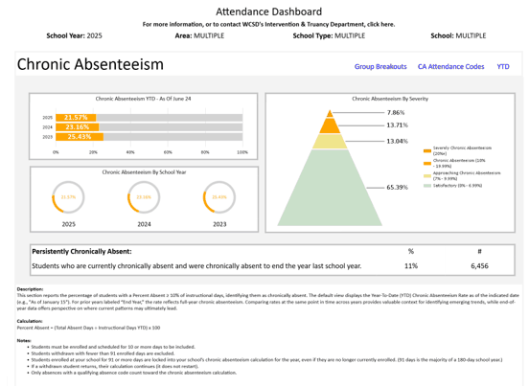
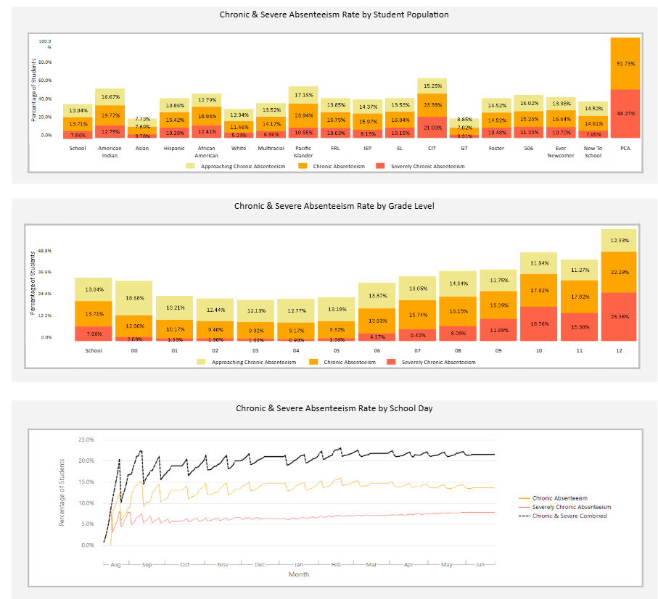
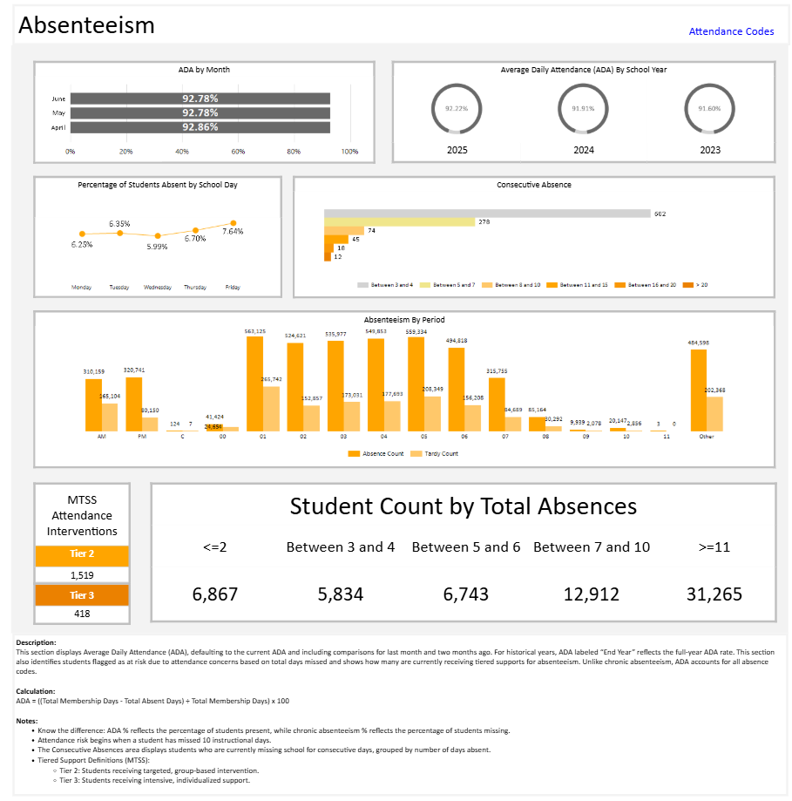
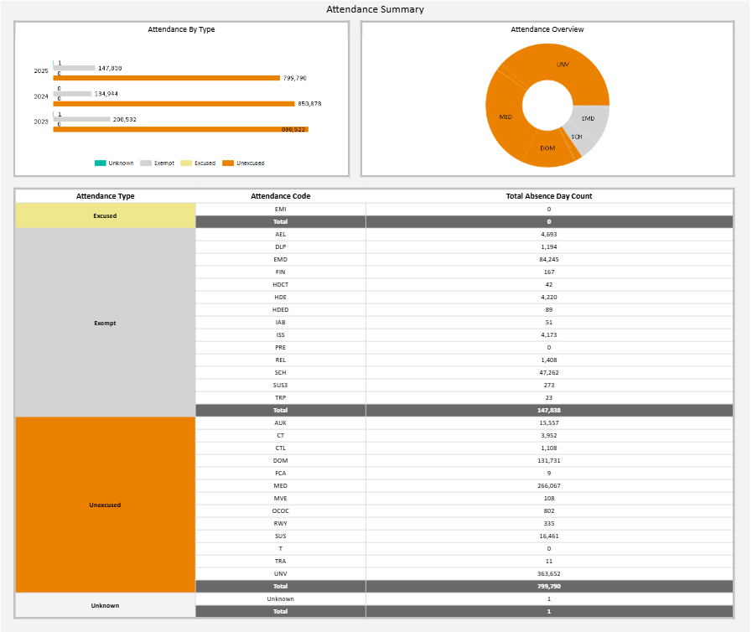
Considering All Aspects of Absenteeism Data
Chronic Absenteeism
CA by Grade Level & Student Populations
ALL Absenteeism
Reasons for Absences
Notes:
5- minutes

Slide 12
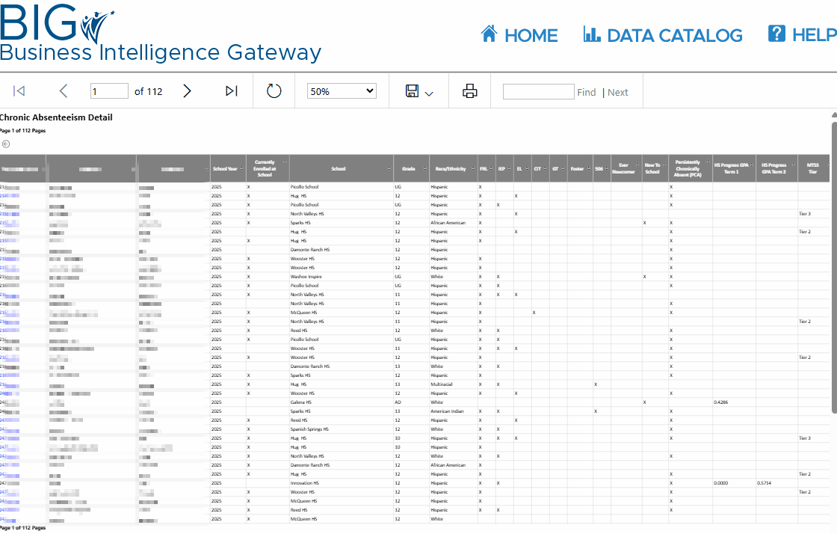
More Analysis Available at Student-Level
Export your BIG report to Excel
Consider other data related to the student with absenteeism
Filter & Sort
Compare days absent from different dates
FIND CELEBRATIONS!
Notes:
20 minutes
Pass to Kyle, Export to excel, focus on actual students behind data, start considering other data with absenteeism. Focus on filtering, sorting, and comparing dates. (12-13 min?)
Practice at tables (7-8 min?)

Slide 13
Turn Your Data Analysis Into Action
As you’ll learn more deeply in the Connectedness session, connection and learning are interdependent, and disconnection is hard to spot in reports. So, while we’ve spent today understanding absenteeism patterns through the dashboard, we want to push further and gather new information to understand the patterns we see.
You have a spreadsheet from BIG that has the exact students you want to see growth from.
Start taking note of which students you or your staff intentionally connect with, start with those who may not yet have a trusted adult or identified peer connection.
Literally track this: Add a new column to your spreadsheet and call it something simple like “Connection Established” and track “Trusted Adult,” “Peer Connection,” “Both,” or “None.”
Notes:
5 minutes
Pass to Laura, keep spreadsheet open, start creating columns and entering information when she is talking about manually tracking specific qualitative efforts.

Slide 14
Leverage AI for Knowledge and Efficiency
You don’t have to start from scratch.
Use AI to give you a head start and help realize your curiosities
Try these prompts:
“Create a short observation protocol I can use to understand how a student who may feel disconnected is engaging throughout the school day in class, during transitions, lunch, specials, and during group work.”
“Give me 3 student-friendly questions for primary grades I can use to quickly check-in to help build trust and understand what’s going on with a student who’s been absent a lot lately and withdrawn when present.”
Notes:
2-3 minute demo, followed by practice until the session ends after we end on the next slide and ask for questions.
Open CoPilot or ChatGPT and do the prompt. For each one, don’t accept the initial reply. Build upon the request iteratively to demonstrate how to get useful output from AI.
Handout: Provide 5 prompts to assist in bringing qualitative information to the analysis and action.

Slide 15



Questions & Contact Information
Happy to answer any questions you have!
Contact Us Anytime!
Dr. Laura Davidson
Director of Research & Evaluation
ldavidson@washoeschools.net
Dr. JT Stark
Data Analytics Coordinator
jstark@washoeschools.net
Kyle Kemp
Accountability Coordinator
kkemp@washoeschools.net
Notes:
Quick ending to ask for questions. “Any questions before we let you loose on AI?”

Slide 16

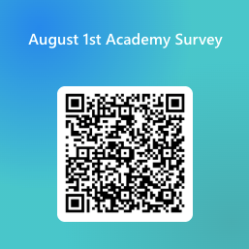
Academy Survey
Notes:
Quick ending to ask for questions. “Any questions before we let you loose on AI?”

